Slide 1
CSE 417T Introduction to Machine Learning
Lecture 11 Instructor: Chien-Ju (CJ) Ho

Slide 2
Logistics
Homework 2: due on Oct 7 (Friday)
Exam 1: October 27 (Thursday)
Topics: LFD Chapters 1 to 5
Timed exam (75 min) during lecture time
Location TBD
Closed-book exam with 2 letter-size cheat sheets allowed (4 pages in total)
No format limitations (it can be typed, written, or a combination)
Homework 3 will be posted later this week
Expect a shorter period of time for working on it (around 1.5 weeks)
Expected due: Mar 5 (Saturday)

Slide 3
Recap

Slide 4
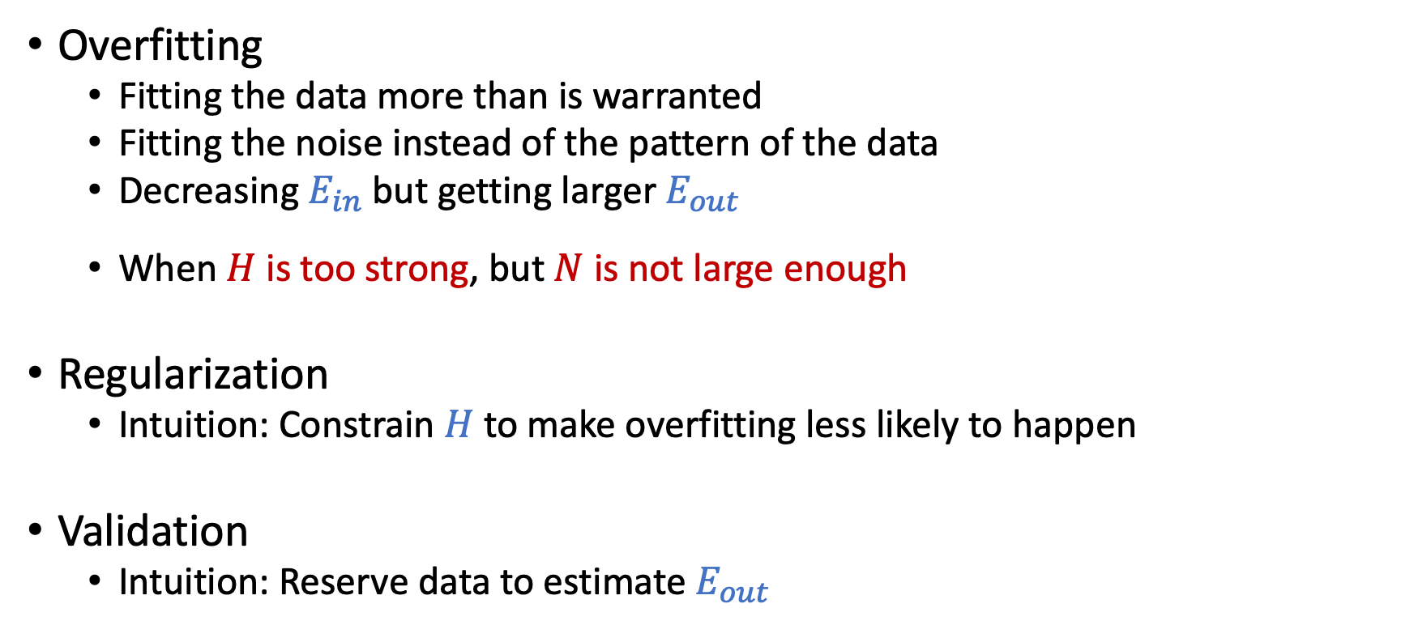
Overfitting and Its Cures
Overfitting
Fitting the data more than is warranted
Fitting the noise instead of the pattern of the data
Decreasing $E_{in}$ but getting larger $E_{out}$
When $H$ is too strong, but $N$ is not large enough
Regularization
Intuition: Constrain $H$to make overfitting less likely to happen
Validation
Intuition: Reserve data to estimate $E_{out}$

Slide 5

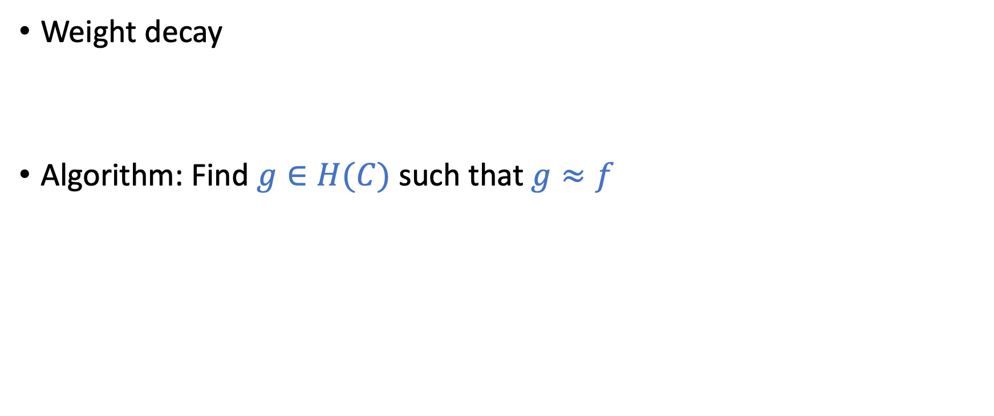
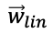
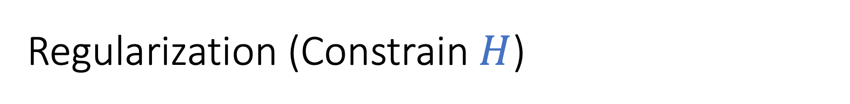
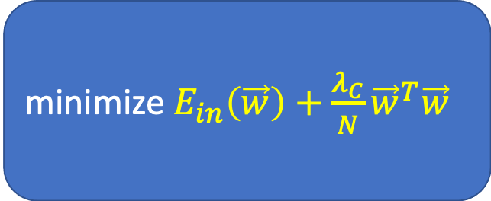
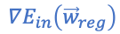
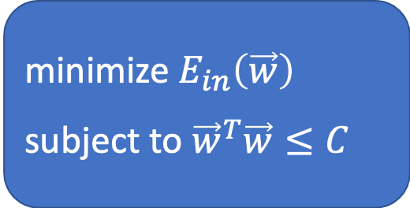
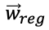
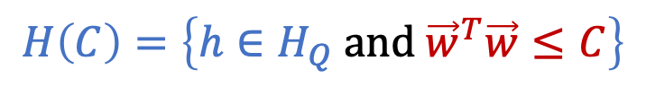
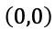
Regularization (Constrain $H$)
Weight decay
Algorithm: Find $g∈H(C)$ such that $g≈f$
$${\vec{w}}_{lin}$$
$$H\left(C\right)=\left\{h∈H_{Q} \text{and} {\vec{w}}^{T}\vec{w}≤C\right\}$$
$${\vec{w}}_{reg}$$
$$∇E_{in}\left({\vec{w}}_{reg}\right)$$
$$\left(0,0\right)$$
$${\vec{w}}^{T}\vec{w}=C$$
Constrained optimization
Unconstrained optimization
minimize $E_{in}\left(\vec{w}\right)$
subject to ${\vec{w}}^{T}\vec{w}≤C$
minimize $E_{in}\left(\vec{w}\right)+\frac{λ_{C}}{N}{\vec{w}}^{T}\vec{w}$
equivalent
Augmented error

Slide 6
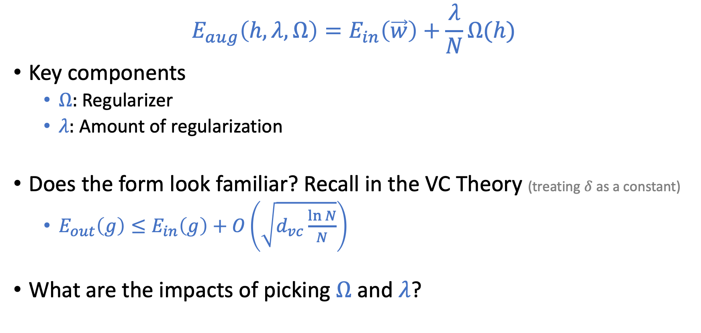
Augmented Error
$$E_{aug}\left(h,λ,Ω\right)=E_{in}\left(\vec{w}\right)+\frac{λ}{N}Ω(h)$$
Key components
$Ω:$ Regularizer
$λ:$ Amount of regularization
Does the form look familiar? Recall in the VC Theory (treating $δ$ as a constant)
$E_{out}\left(g\right)≤E_{in}\left(g\right)+O\left(\sqrt{d_{vc}\frac{\ln{N}}{N}}\right)$
What are the impacts of picking $Ω$ and $λ$?

Slide 7
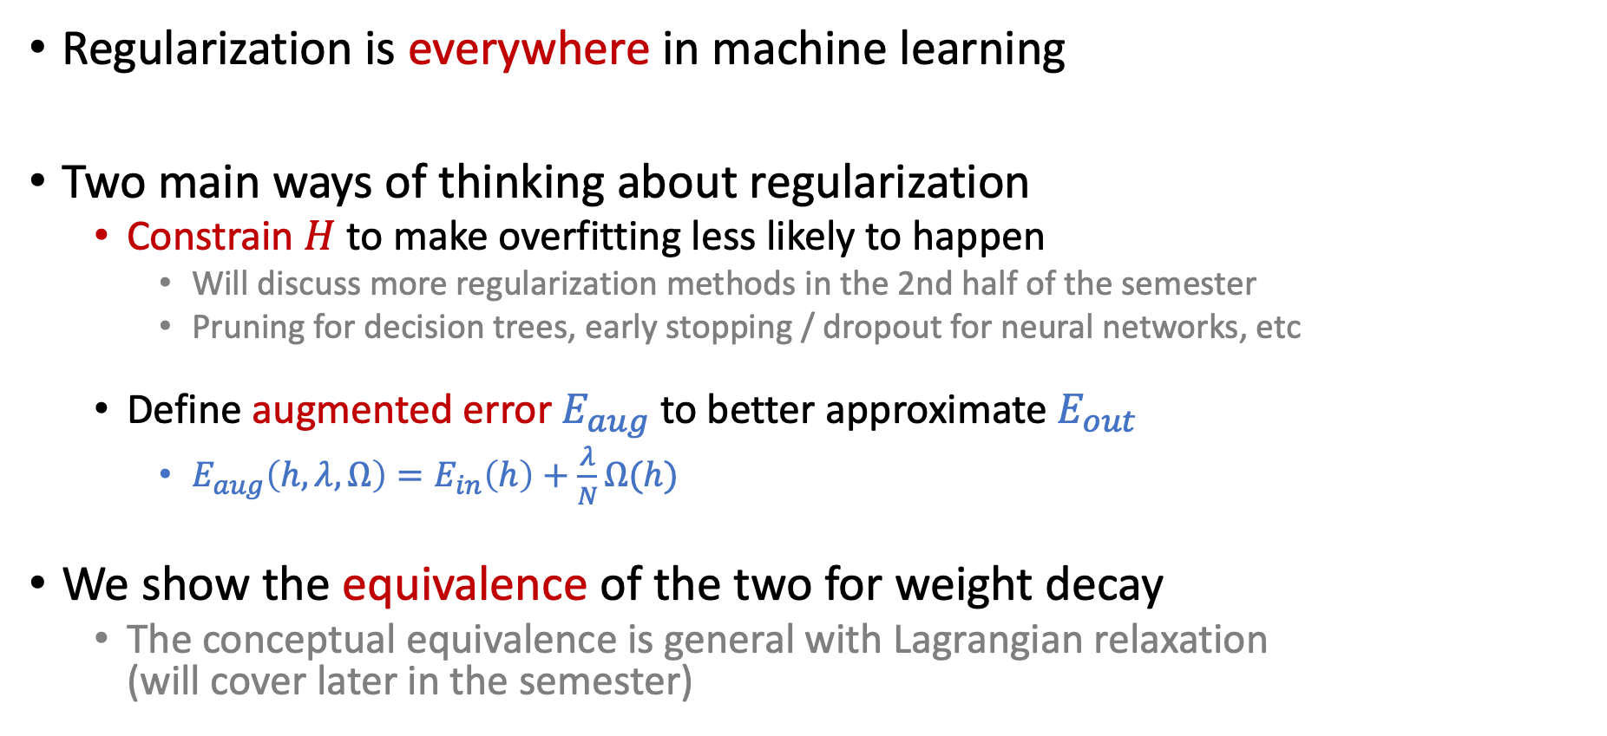
Summary of Regularization
Regularization is everywhere in machine learning
Two main ways of thinking about regularization
Constrain $H$ to make overfitting less likely to happen
Will discuss more regularization methods in the 2nd half of the semester
Pruning for decision trees, early stopping / dropout for neural networks, etc
Define augmented error $E_{aug}$ to better approximate $E_{out}$
$E_{aug}\left(h,λ,Ω\right)=E_{in}\left(h\right)+\frac{λ}{N}Ω(h)$
We show the equivalence of the two for weight decay
The conceptual equivalence is general with Lagrangian relaxation (will cover later in the semester)

Slide 8
Today’s Lecture
The notes are not intended to be comprehensive. They should be accompanied by lectures and/or textbook.
Let me know if you spot errors.

Slide 9
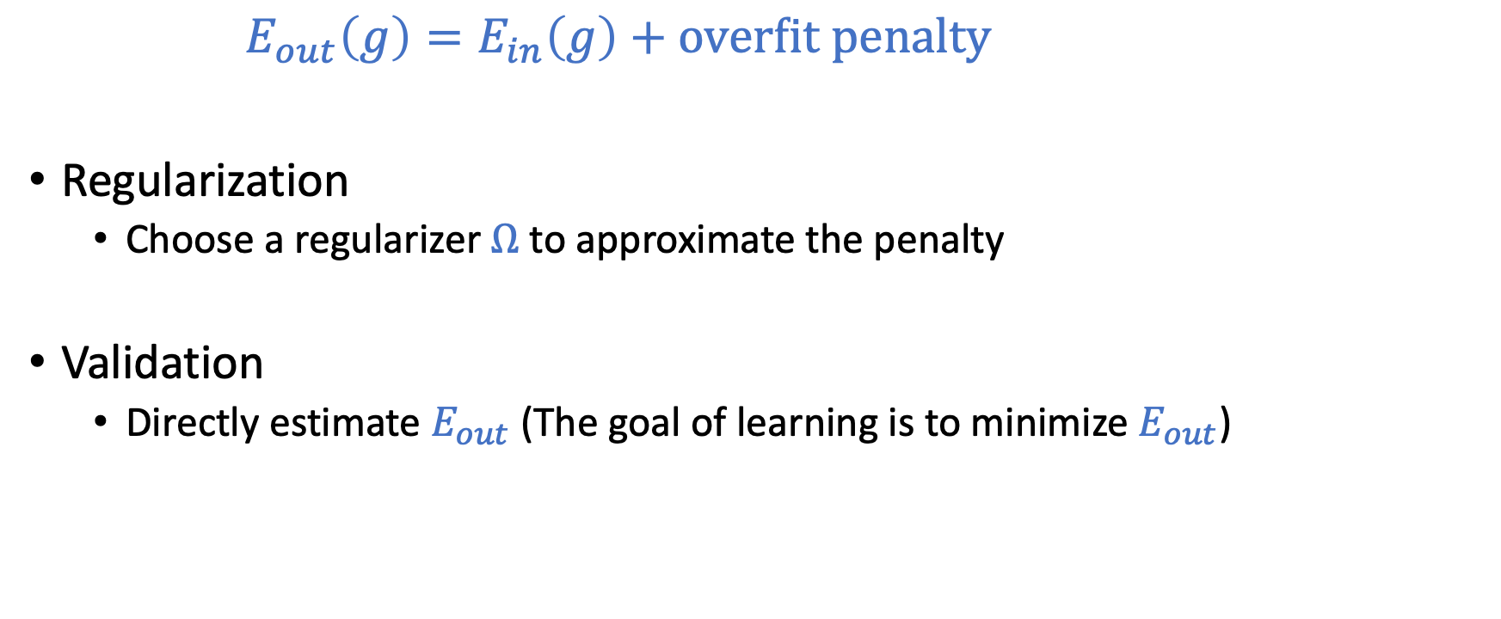
Prevent Overfitting
$E_{out}\left(g\right)=E_{in}\left(g\right)+\text{overfit} \text{penalty}$
Regularization
Choose a regularizer $Ω$ to approximate the penalty
Validation
Directly estimate $E_{out}$ (The goal of learning is to minimize $E_{out}$)

Slide 10
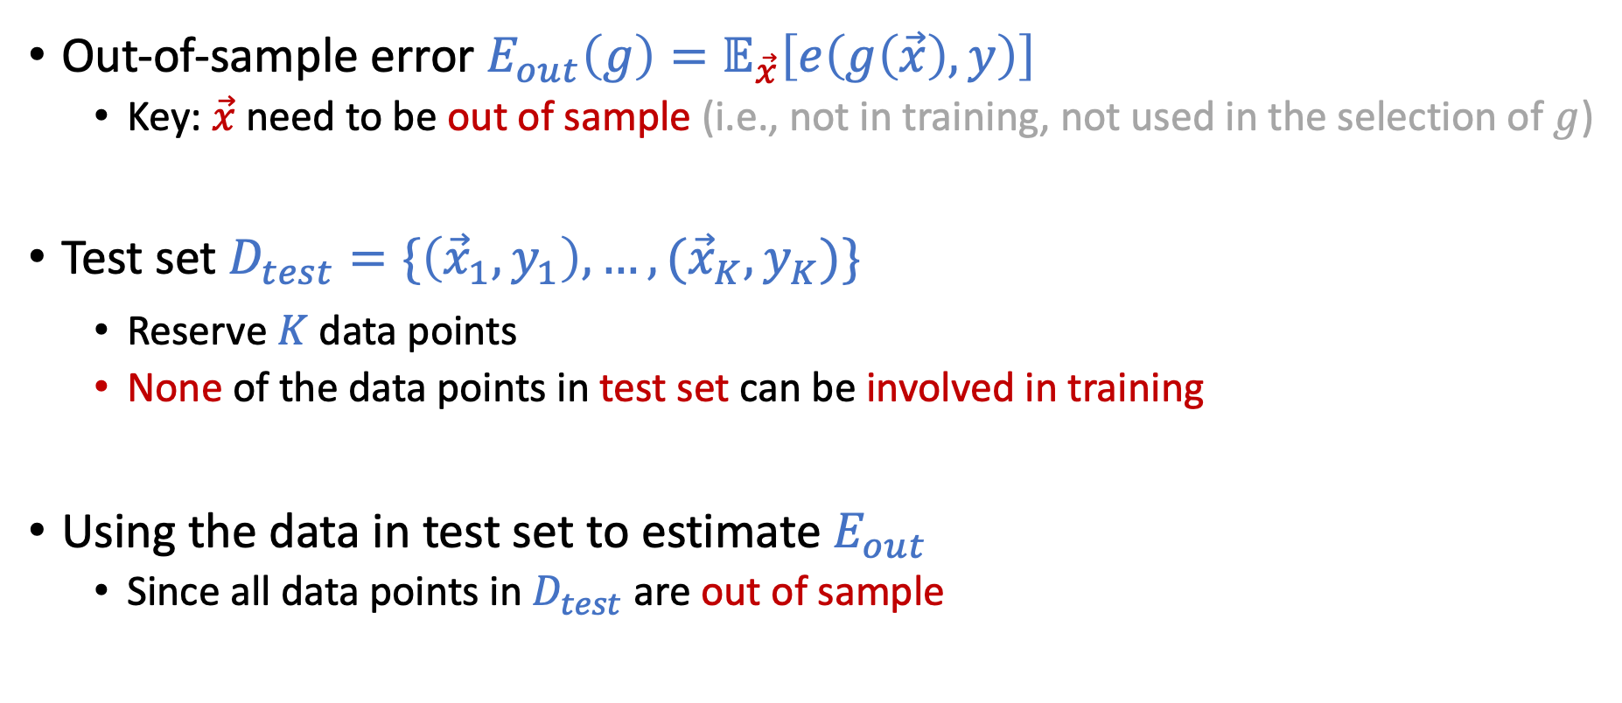

Review of Test Set (Estimate $E_{out}$)
Out-of-sample error $E_{out}\left(g\right)=𝔼_{\vec{x}}\left[e\left(g\left(\vec{x}\right),y\right)\right]$
Key: $\vec{x}$ need to be out of sample (i.e., not in training, not used in the selection of $g$)
Test set $D_{test}=\{\left({\vec{x}}_{1},y_{1}\right),…,({\vec{x}}_{K},y_{K})\}$
Reserve $K$ data points
None of the data points in test set can be involved in training
Using the data in test set to estimate $E_{out}$
Since all data points in $D_{test}$ are out of sample

Slide 11
Short Discussion on HW2
In HW2, you are asked to perform “normalization” on the training/test datasets. How should you do it?
Calculate the mean/variance of the combined data. Normalize them using the overall mean/variance.
Calculate the means/variances of the training and test datasets separately. Normalize them using their respective mean/variance.
Calculate the mean/variance of the training dataset. Normalize both datasets using the training mean/variance.

Slide 12
Short Discussion on HW2
In HW2, you are asked to perform “normalization” on the training/test datasets. How should you do it?
Calculate the mean/variance of the combined data. Normalize them using the overall mean/variance.
Calculate the means/variances of the training and test datasets separately. Normalize them using their respective mean/variance.
Calculate the mean/variance of the training dataset. Normalize both datasets using the training mean/variance.
Two important properties we want to preserve
Training and test data are drawn from the same distribution.
Test data is never used in training.

Slide 13
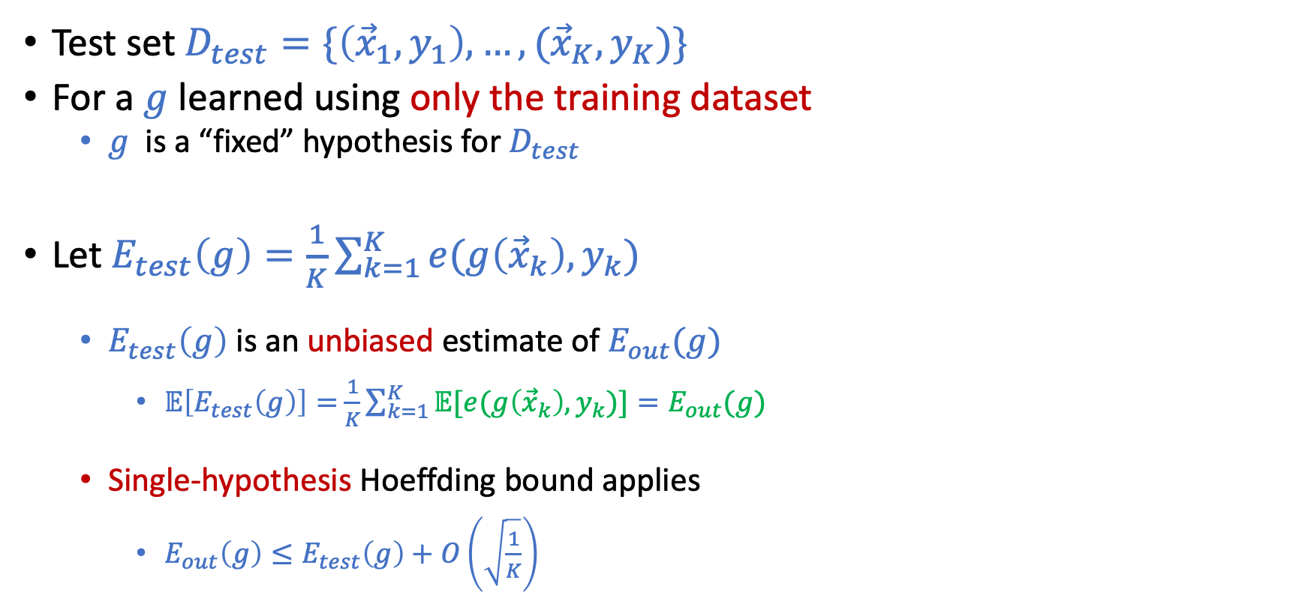

Test Set
Test set $D_{test}=\{\left({\vec{x}}_{1},y_{1}\right),…,({\vec{x}}_{K},y_{K})\}$
For a $g$ learned using only the training dataset
$g$ is a “fixed” hypothesis for $D_{test}$
Let $E_{test}\left(g\right)=\frac{1}{K}\sum_{k=1}^{K}{e(g\left({\vec{x}}_{k}\right),y_{k})}$
$E_{test}\left(g\right)$ is an unbiased estimate of $E_{out}(g)$
$𝔼\left[E_{test}\left(g\right)\right]=$ $\frac{1}{K}\sum_{k=1}^{K}{𝔼[e(g\left({\vec{x}}_{k}\right),y_{k})}]=E_{out}(g)$
Single-hypothesis Hoeffding bound applies
$E_{out}\left(g\right)≤E_{test}\left(g\right)+O\left(\sqrt{\frac{1}{K}}\right)$
$K$: number of samples

Slide 14
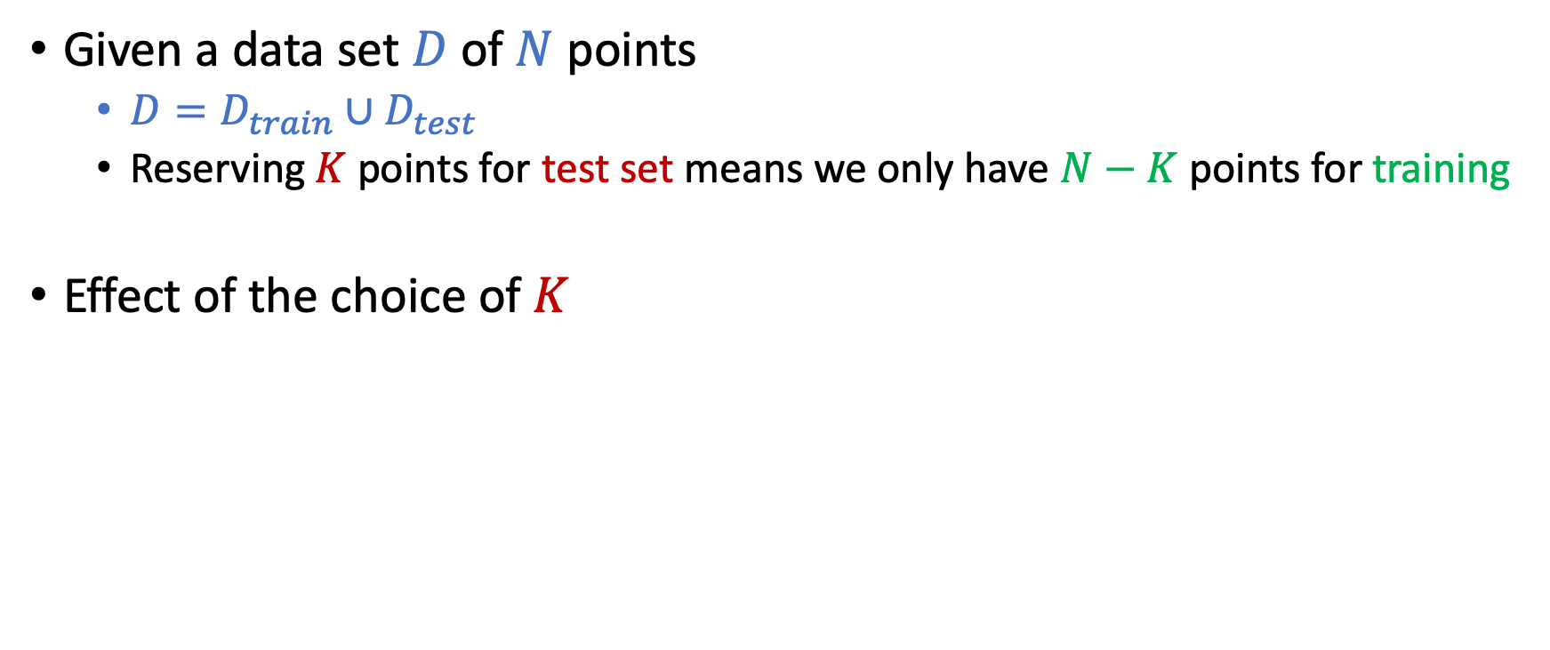
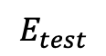
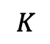
Where are Test Set From?
Given a data set $D$of $N$ points
$D=D_{train}∪D_{test}$
Reserving $K$ points for test set means we only have $N−K$ points for training
Effect of the choice of $K$
$$E_{test}$$
$$K$$

Slide 15
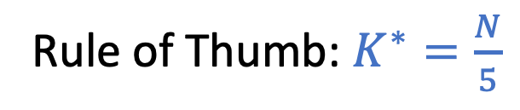
Where are Test Set From?
Given a data set $D$of $N$ points
$D=D_{train}∪D_{test}$
Reserving $K$ points for test set means we only have $N−K$ points for training
Effect of the choice of $K$
Rule of Thumb: $K^{∗}=\frac{N}{5}$
$$E_{test}$$
$$K$$

Slide 16
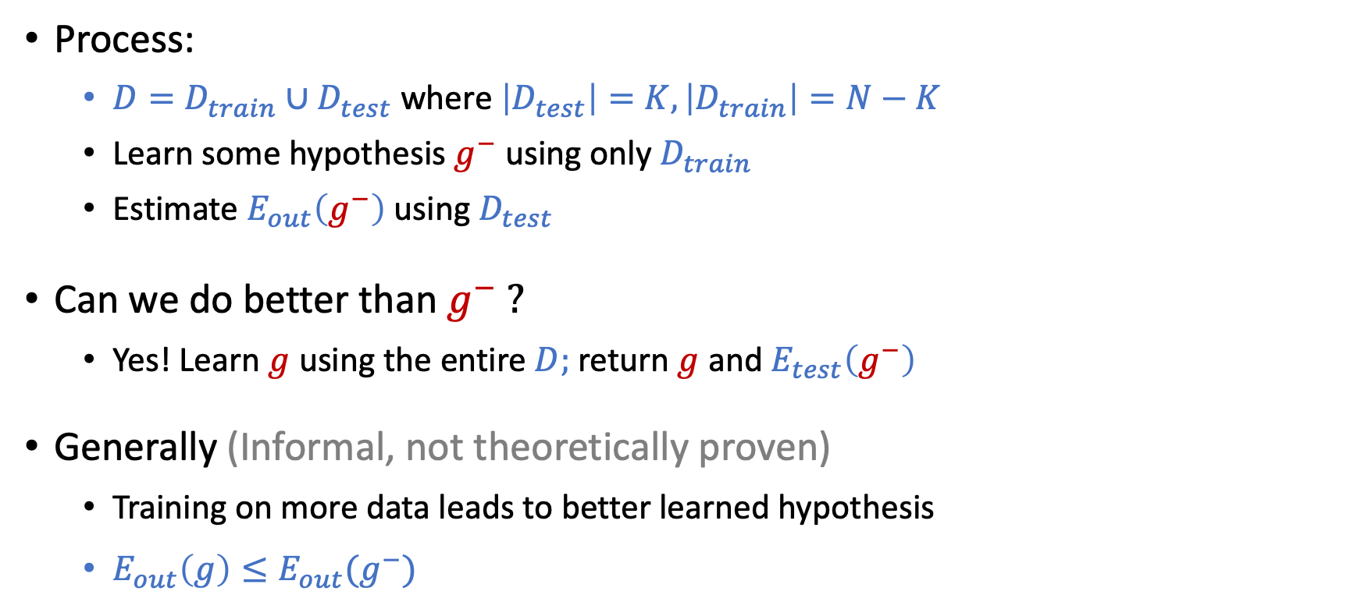
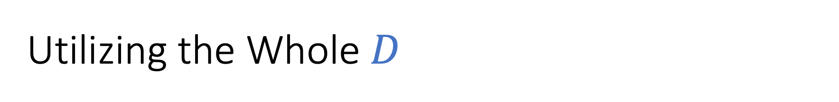
Utilizing the Whole $D$
Process:
$D=D_{train}∪D_{test}$ where $\left|D_{test}\right|=K, \left|D_{train}\right|=N−K$
Learn some hypothesis $g^{−}$ using only $D_{train}$
Estimate $E_{out}\left(g^{−}\right)$ using $D_{test}$
Can we do better than $g^{−} ?$
Yes! Learn $g$ using the entire $D;$ return $g$ and $E_{test}\left(g^{−}\right)$
Generally (Informal, not theoretically proven)
Training on more data leads to better learned hypothesis
$E_{out}\left(g\right)≤E_{out}(g^{−})$

Slide 17

Validation: Beyond Test Set
What if we want to estimate $E_{out}$ multiple times?

Slide 18
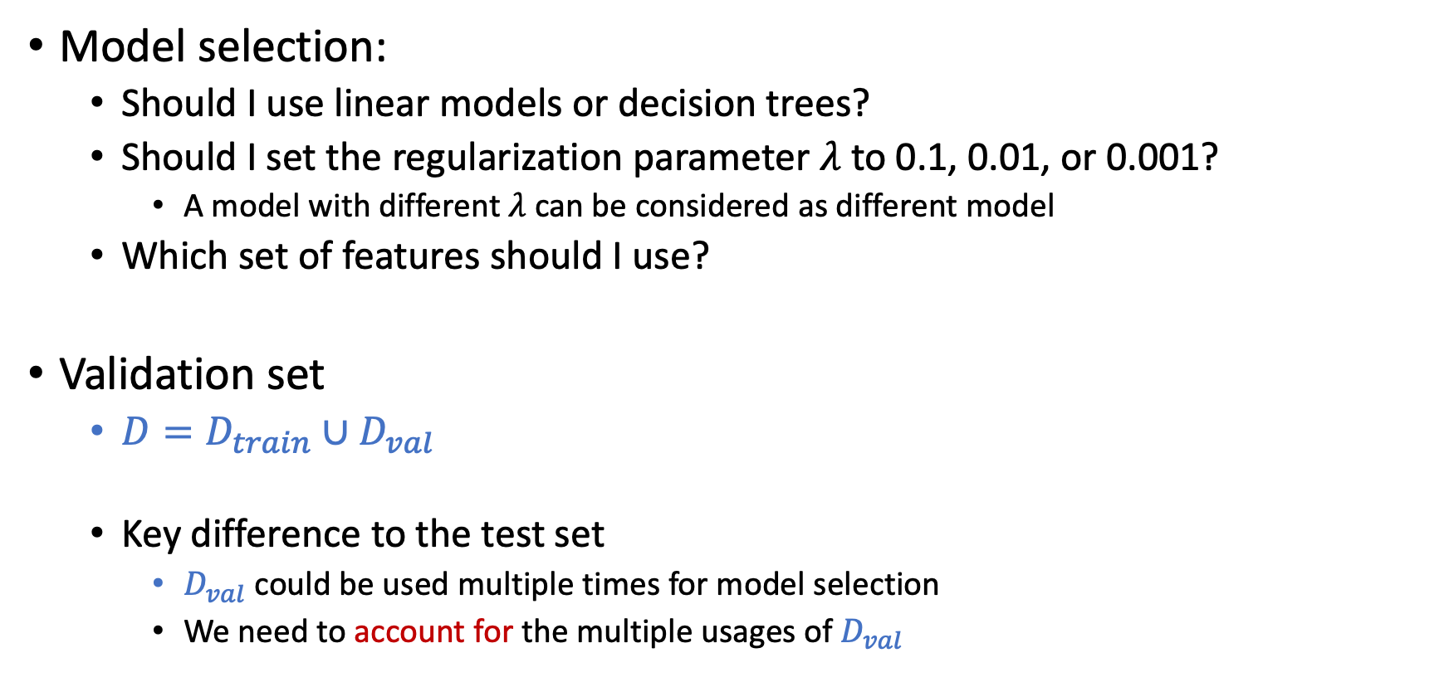
Validation: Beyond Test Set
Model selection:
Should I use linear models or decision trees?
Should I set the regularization parameter $λ$ to 0.1, 0.01, or 0.001?
A model with different $λ$ can be considered as different model
Which set of features should I use?
Validation set
$D=D_{train}∪D_{val}$
Key difference to the test set
$D_{val}$ could be used multiple times for model selection
We need to account for the multiple usages of $D_{val}$

Slide 19
Model Selection
Which model should we choose?

Slide 20
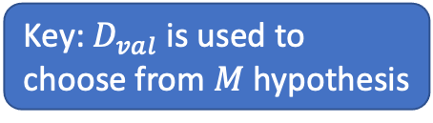
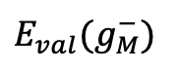
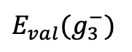
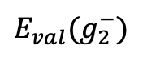
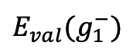
Model Selection using Validation
Which model should we choose?
Key: $D_{val}$ is used to choose from $M$ hypothesis
$$E_{val}(g_{1}^{−})$$
$$E_{val}(g_{2}^{−})$$
$$E_{val}(g_{3}^{−})$$
$$E_{val}(g_{M}^{−})$$
Choose $H_{m^{∗}}$ such that $E_{val}(g_{m^{∗}}^{−})≤E_{val}(g_{m}^{−})$ for all $m$

Slide 21
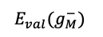
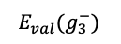
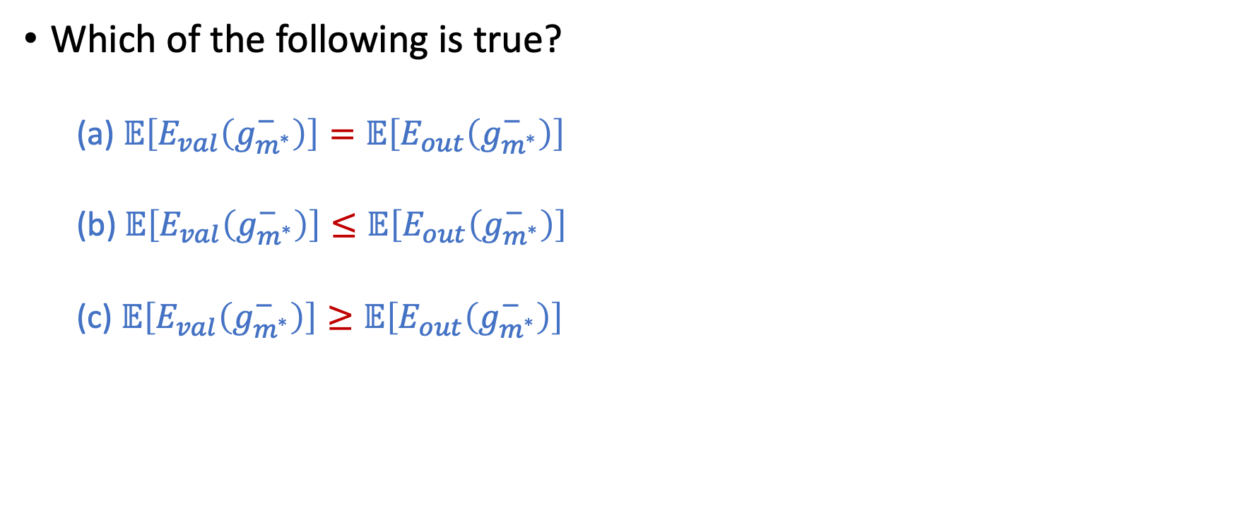
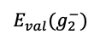
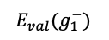
Question…
Which of the following is true?
(a) $𝔼\left[E_{val}\left(g_{m^{∗}}^{−}\right)\right]=𝔼\left[E_{out}\left(g_{m^{∗}}^{−}\right)\right]$
(b) $𝔼\left[E_{val}\left(g_{m^{∗}}^{−}\right)\right]≤𝔼\left[E_{out}\left(g_{m^{∗}}^{−}\right)\right]$
(c) $𝔼\left[E_{val}\left(g_{m^{∗}}^{−}\right)\right]≥𝔼\left[E_{out}\left(g_{m^{∗}}^{−}\right)\right]$
$$E_{val}(g_{1}^{−})$$
$$E_{val}(g_{2}^{−})$$
$$E_{val}(g_{3}^{−})$$
$$E_{val}(g_{M}^{−})$$
Choose $H_{m^{∗}}$ such that $E_{val}(g_{m^{∗}}^{−})≤E_{val}\left(g_{m}^{−}\right)$ for all $m$

Slide 22
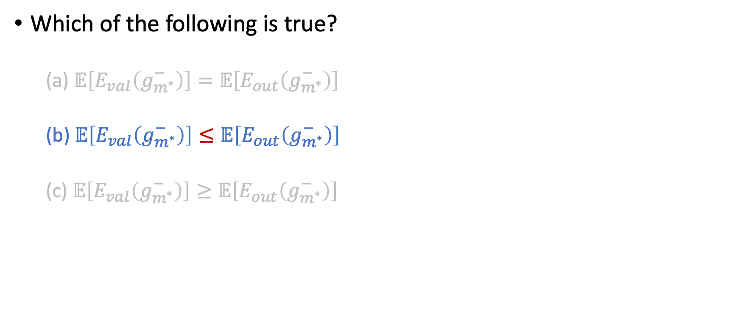
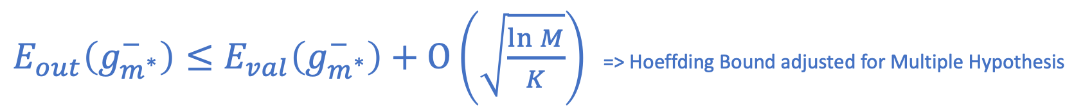
Question…
Which of the following is true?
(a) $𝔼\left[E_{val}\left(g_{m^{∗}}^{−}\right)\right]=𝔼\left[E_{out}\left(g_{m^{∗}}^{−}\right)\right]$
(b) $𝔼\left[E_{val}\left(g_{m^{∗}}^{−}\right)\right]≤𝔼\left[E_{out}\left(g_{m^{∗}}^{−}\right)\right]$
(c) $𝔼\left[E_{val}\left(g_{m^{∗}}^{−}\right)\right]≥𝔼\left[E_{out}\left(g_{m^{∗}}^{−}\right)\right]$
$$E_{val}(g_{1}^{−})$$
$$E_{val}(g_{2}^{−})$$
$$E_{val}(g_{3}^{−})$$
$$E_{val}(g_{M}^{−})$$
Choose $H_{m^{∗}}$ such that $E_{val}(g_{m^{∗}}^{−})≤E_{val}(g_{m}^{−})$ for all $m$
Equivalent to use $D_{val}$ to choose from $H=\{g_{1}^{−},…,g_{M}^{−}\}$
$E_{out}\left(g_{m^{∗}}^{−}\right)≤E_{val}\left(g_{m^{∗}}^{−}\right)+O\left(\sqrt{\frac{\ln{M}}{K}}\right)$ => Hoeffding Bound adjusted for Multiple Hypothesis

Slide 23
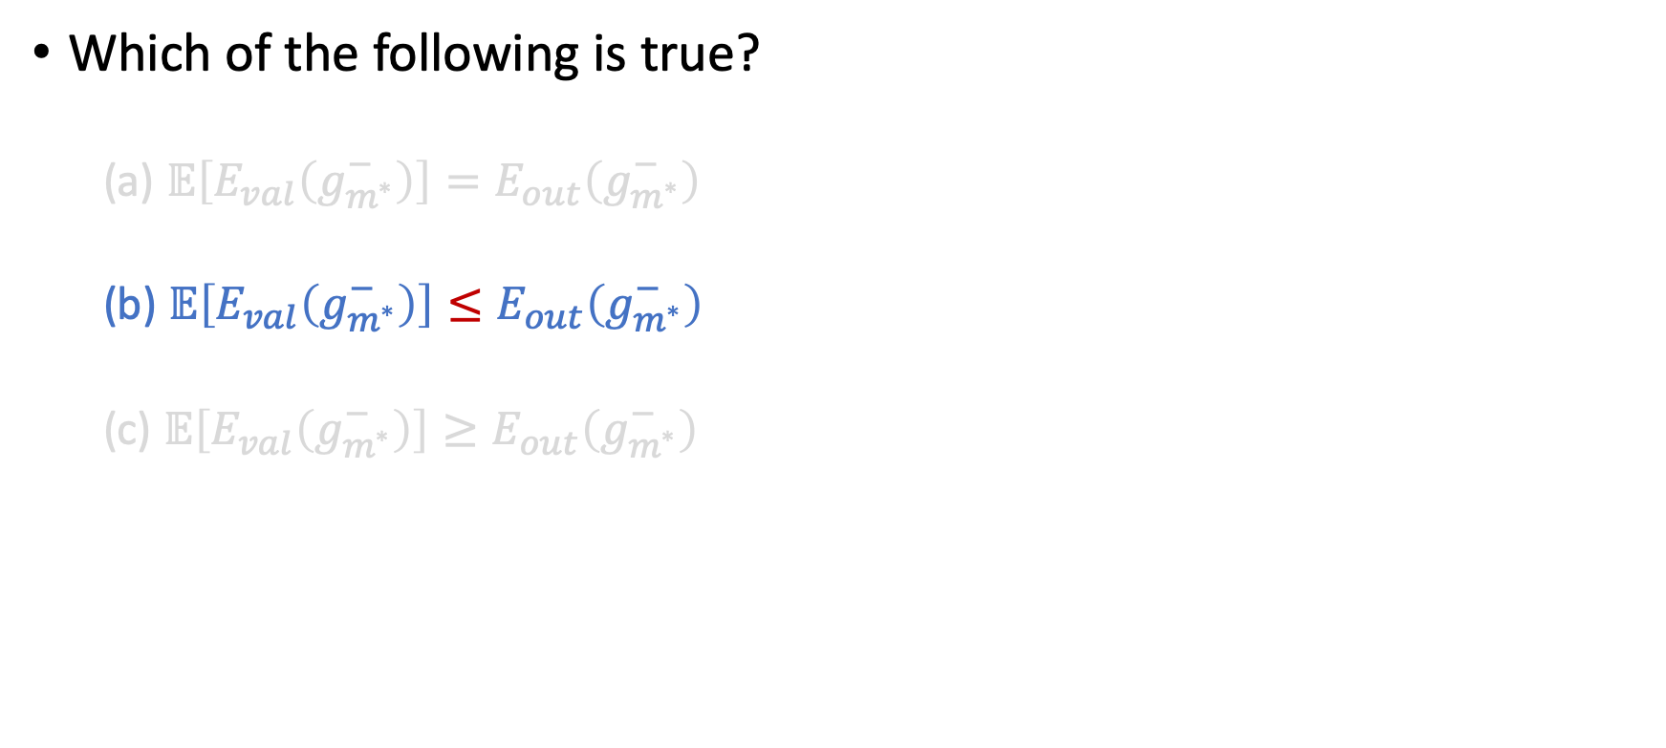
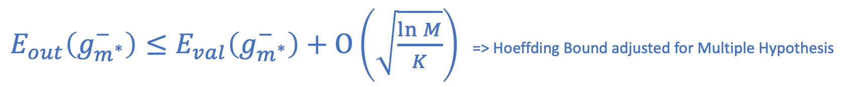
Question…
Which of the following is true?
(a) $𝔼\left[E_{val}\left(g_{m^{∗}}^{−}\right)\right]=E_{out}\left(g_{m^{∗}}^{−}\right)$
(b) $𝔼\left[E_{val}\left(g_{m^{∗}}^{−}\right)\right]≤E_{out}\left(g_{m^{∗}}^{−}\right)$
(c) $𝔼\left[E_{val}\left(g_{m^{∗}}^{−}\right)\right]≥E_{out}\left(g_{m^{∗}}^{−}\right)$
Equivalent to use $D_{val}$ to choose from $H=\{g_{1}^{−},…,g_{M}^{−}\}$
$E_{out}\left(g_{m^{∗}}^{−}\right)≤E_{val}\left(g_{m^{∗}}^{−}\right)+O\left(\sqrt{\frac{\ln{M}}{K}}\right)$ => Hoeffding Bound adjusted for Multiple Hypothesis

Slide 24
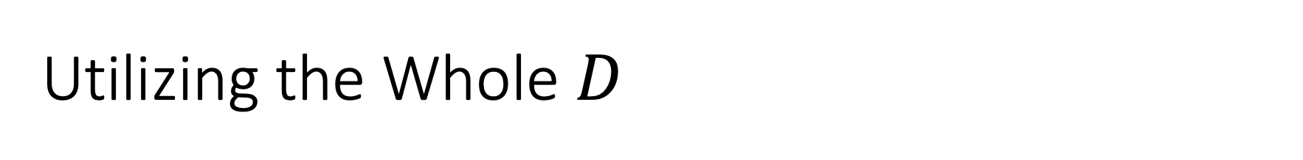
Utilizing the Whole $D$
$g_{\hat{m}}:$ the hypothesis minimizes in-sample error over {$H_{1},…,H_{M}$}

Slide 25
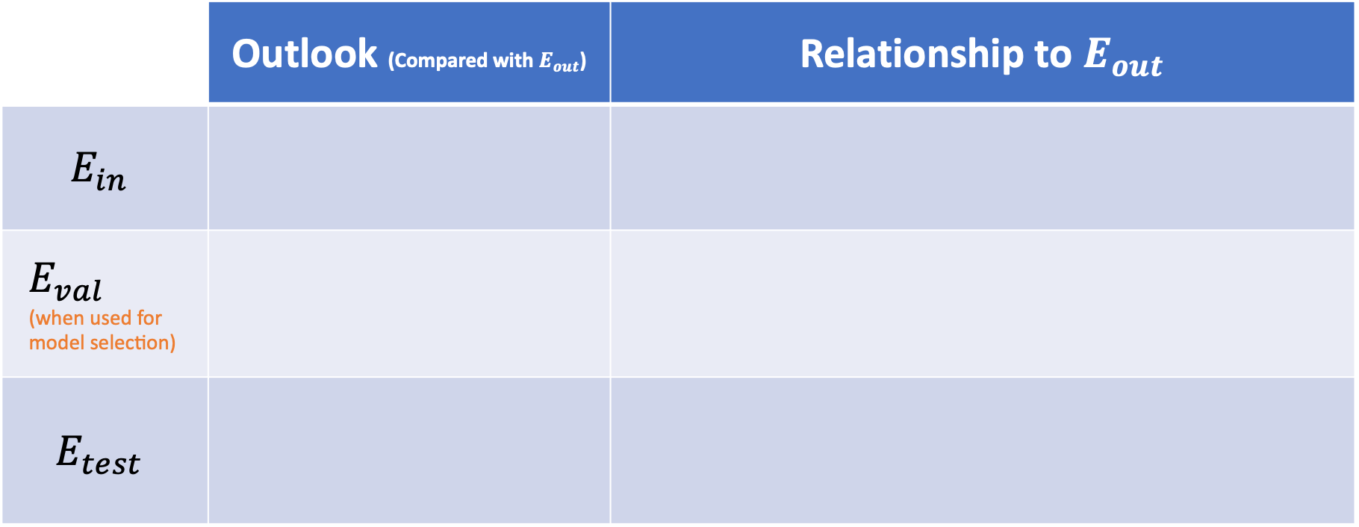
 | Outlook (Compared with $E_{out}$) | Relationship to $E_{out}$
$$E_{in}$$
$$E_{val} \\ \text{(}\text{when} \text{used} \text{for} \text{model} \text{selection}\text{)}$$
$$E_{test}$$
When a validation set is not used for model selection, it is essentially a test set

Slide 26
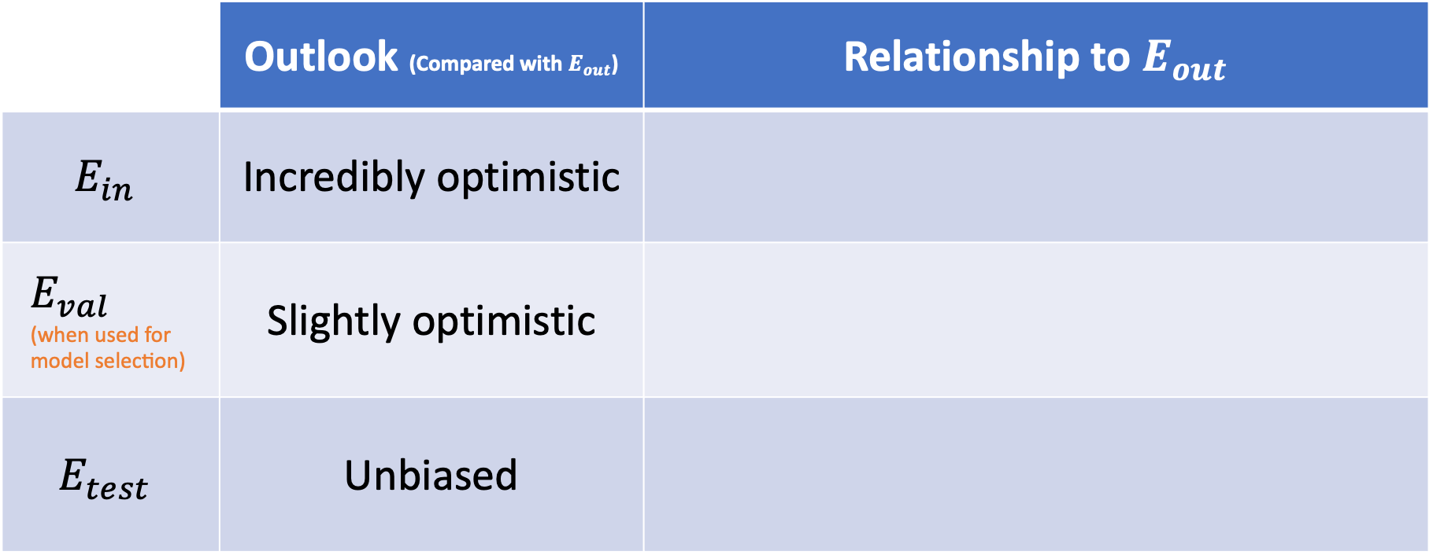
 | Outlook (Compared with $E_{out}$) | Relationship to $E_{out}$
$$E_{in}$$ | Incredibly optimistic
$$E_{val} \\ \text{(}\text{when} \text{used} \text{for} \text{model} \text{selection}\text{)}$$ | Slightly optimistic
$$E_{test}$$ | Unbiased

Slide 27
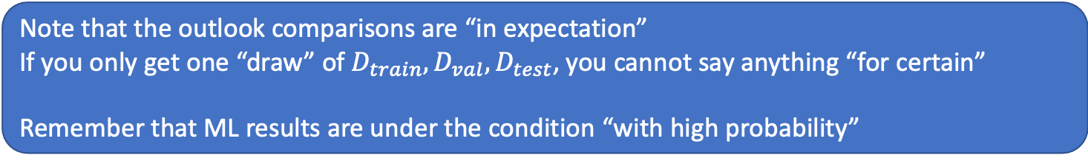
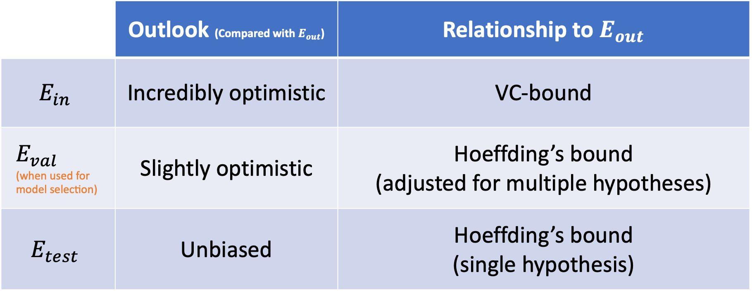
 | Outlook (Compared with $E_{out}$) | Relationship to $E_{out}$
$$E_{in}$$ | Incredibly optimistic | VC-bound
$$E_{val} \\ \text{(}\text{when} \text{used} \text{for} \text{model} \text{selection}\text{)}$$ | Slightly optimistic | Hoeffding’s bound (adjusted for multiple hypotheses)
$$E_{test}$$ | Unbiased | Hoeffding’s bound (single hypothesis)
Note that the outlook comparisons are “in expectation”
If you only get one “draw” of $D_{train}, D_{val}, D_{test}$, you cannot say anything “for certain”
Remember that ML results are under the condition “with high probability”

Slide 28
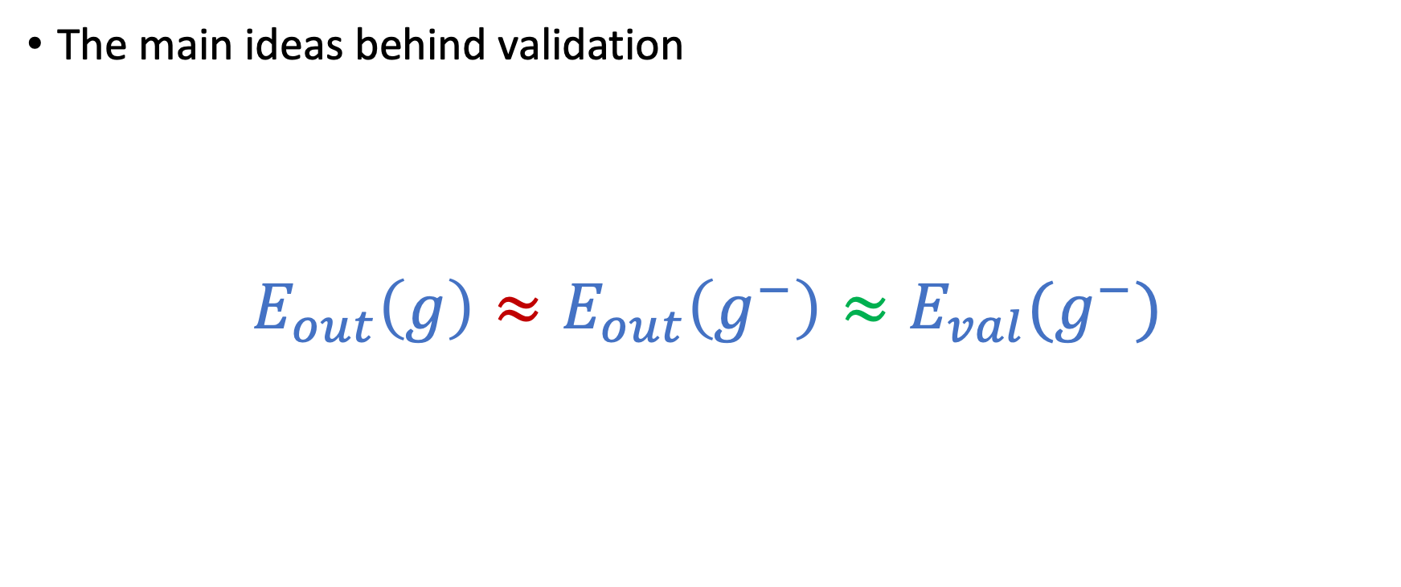

The Dilemma When Choosing $K$
The main ideas behind validation
$$E_{out}\left(g\right)≈E_{out}\left(g^{−}\right)≈E_{val}(g^{−})$$

Slide 29
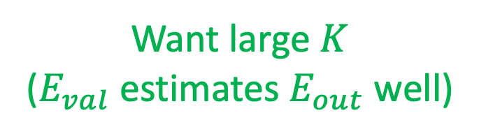
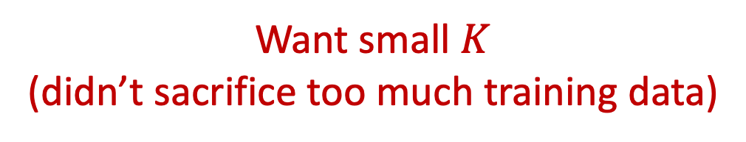
The Dilemma When Choosing $K$
The main ideas behind validation
$$E_{out}\left(g\right)≈E_{out}\left(g^{−}\right)≈E_{val}(g^{−})$$
Want large $K$
($E_{val}$ estimates $E_{out}$ well)
Want small $K$
(didn’t sacrifice too much training data)

Slide 30
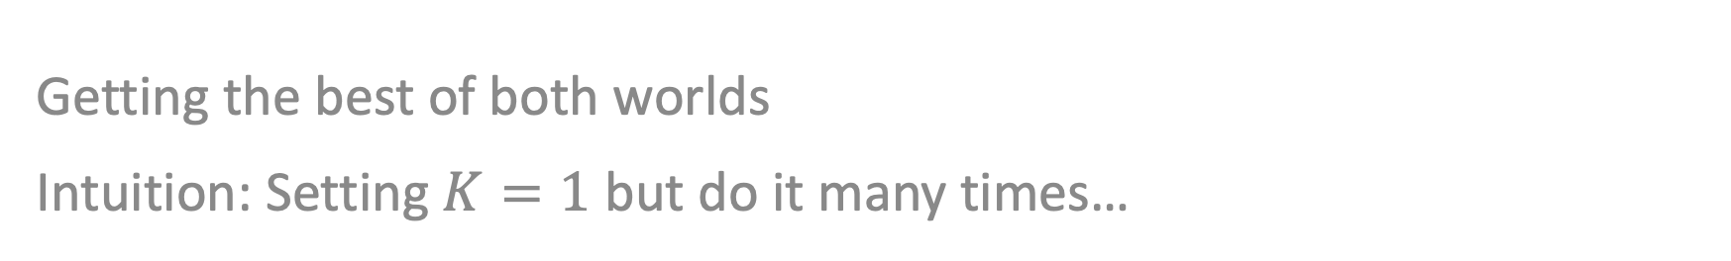
Leave-One-Out Cross Validation (LOOCV)
Getting the best of both worlds Intuition: Setting $K=1$ but do it many times…

Slide 31
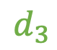
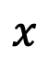
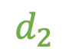
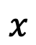
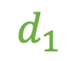



Illustrative Example
$$d_{2}$$
$$d_{3}$$
$$y$$
$$d_{1}$$
$$x$$
$$x$$
$$x$$
$$E_{cv}= \frac{1}{3}\left(d_{1}^{2}+d_{2}^{2}+d_{3}^{2}\right)$$

Slide 32

Properties of LOOCV
LOOCV is unbiased (If *not* used for model selection)
$E_{CV}$ is an unbiased estimator of ${\overline{E}}_{out}\left(N−1\right)$
(expected $E_{out}$ when learning on $N−1$ points)
The “effective number” of examples in $E_{CV}$ estimation is high for LOOCV
However, LOOCV is computationally expensive
Need to train $N$ models, each on $N−1$ points

Slide 33

V-Fold Cross Validation
Split $D$ into $V$ equally sized data sets: $D_{1},D_{2},…,D_{V}$
Let $g_{i}^{−}$ be the hypothesis learned using all data sets except $D_{i}$
Let $e_{i}=E_{val}\left(g_{i}^{−}\right)$ where the validation uses data set $D_{i}$
The $V$-fold cross validation error is $\frac{1}{V}\sum_{i=1}^{V}{e_{i}}$
Practical rule of thumb: $V=10$

Slide 34
VC Dimension of d-dim Perceptron

Slide 35

Recall the Definitions
Shatter
$H$ shatters $({\vec{x}}_{1},…,{\vec{x}}_{N})$ if $\left|H\left({\vec{x}}_{1},…,{\vec{x}}_{N}\right)\right|=2^{N}$
$H$ can induce all label combinations for $({\vec{x}}_{1},…,{\vec{x}}_{N})$
Break point
$k$ is a break point for $H$ if no data set of size $k$ can be shattered by $H$
$k$ is a break point for $H$ $↔m_{H}\left(k\right)<2^{k}$
VC Dimension: $d_{vc}(H)$ or $d_{vc}$
The VC dimension of $H$ is the largest $N$ such that $m_{H}\left(N\right)=2^{N}$
Equivalently, if $k^{∗}$ is the smallest break point for $H$, $d_{vc}\left(H\right)=k^{∗}−1$

Slide 36

VC Dimension of d-dimension Perceptron
Claim:
The VC Dimension of d-dim perceptron is $d+1$
How to prove it?
Show that the VC dimension of d-dim perceptron $≥d+1$
Show that the VC dimension of d-dim perceptron $≤d+1$

Slide 37

To prove $d_{vc}\left(H\right)≥d+1,$ what do we need to prove?
There is a set of $d+1$points that can be shattered by $H$
There is a set of $d+1$points that cannot be shattered by $H$
Every set of $d+1$ points can be shattered by $H$
Every set of $d+1$ points cannot be shattered by $H$

Slide 38

To prove $d_{vc}\left(H\right)≥d+1,$ what do we need to prove?
There is a set of $d+1$points that can be shattered by $H$
There is a set of $d+1$points that cannot be shattered by $H$
Every set of $d+1$ points can be shattered by $H$
Every set of $d+1$ points cannot be shattered by $H$

Slide 39

To prove $d_{vc}\left(H\right)≥d+1,$ what do we need to prove?
There is a set of $d+1$points that can be shattered by $H$
There is a set of $d+1$points that cannot be shattered by $H$
Every set of $d+1$ points can be shattered by $H$
Every set of $d+1$ points cannot be shattered by $H$
To prove $d_{vc}\left(H\right)≤d+1,$ what do we need to prove?
There is a set of $d+1$points that can be shattered by $H$
There is a set of $d+2$points that cannot be shattered by $H$
Every set of $d+2$ points can be shattered by $H$
Every set of $d+1$ points cannot be shattered by $H$
Every set of $d+2$ points cannot be shattered by $H$

Slide 40

To prove $d_{vc}\left(H\right)≥d+1,$ what do we need to prove?
There is a set of $d+1$points that can be shattered by $H$
There is a set of $d+1$points that cannot be shattered by $H$
Every set of $d+1$ points can be shattered by $H$
Every set of $d+1$ points cannot be shattered by $H$
To prove $d_{vc}\left(H\right)≤d+1,$ what do we need to prove?
There is a set of $d+1$points that can be shattered by $H$
There is a set of $d+2$points that cannot be shattered by $H$
Every set of $d+2$ points can be shattered by $H$
Every set of $d+1$ points cannot be shattered by $H$
Every set of $d+2$ points cannot be shattered by $H$

Slide 41

To prove $d_{vc}\left(H\right)≥d+1,$ what do we need to prove? There is a set of $d+1$points that can be shattered by $H$
To prove $d_{vc}\left(H\right)≤d+1,$ what do we need to prove? Every set of $d+2$ points cannot be shattered by $H$

Slide 42


To prove $d_{vc}\left(H\right)≥d+1,$ what do we need to prove? There is a set of $d+1$points that can be shattered by $H$
To prove $d_{vc}\left(H\right)≤d+1,$ what do we need to prove? Every set of $d+2$ points cannot be shattered by $H$
Proof Sketch:
1. Let’s construct a dataset of $d+1$ points: $X=\left[\begin{matrix}{\vec{x}}_{1}^{T} \\ ⋮ \\ {\vec{x}}_{d+1}^{T}\end{matrix}\right]=\left[\begin{matrix}\begin{matrix}1 & 0 & 0 \\ 1 & 0 & 0\end{matrix} & \begin{matrix}… & 0 & 0 \\ … & 0 & 1\end{matrix} \\ \begin{matrix} 1 & 0 & 0 \\ … & … & … \\ 1 & 1 & 0\end{matrix} & \begin{matrix}… & 1 & 0 \\ … & … & … \\ … & 0 & 0\end{matrix}\end{matrix}\right]$; It’s easy to check that $X^{−1}$ exist
2. For any possible dichotomy $\vec{y},$ there exists a $\vec{w}$ such that $X\vec{w}=\vec{y},$ i.e., $\vec{w}=X^{−1}\vec{y}$
3. Therefore, d-dim perceptron can shatter $X$
Proof Sketch:
For every set of $d+2$ points (in d+1 dimensions), there exists a point that can be written as linear combinations of the others.
Denote the point ${\vec{x}}_{d+2}$, we have ${\vec{x}}_{d+2}=\sum_{i=1}^{d+1}{a_{i}}{\vec{x}}_{i}$
Consider the dichotomy ($y_{1},…,y_{d+2})=(sign\left(a_{1}\right),…,sign\left(a_{d+1}\right), −1)$, we can show that no linear separator can generate this dichotomy (think about why).
Therefore, for every set of $d+2$ points, there exist at least one dichotomy that $H$ cannot induce.

Slide 43

VC “Dimension”
Degrees of freedom for your hypothesis in $H$
(effective) # of parameters that control the hypothesis
Examples:
d-dim perceptron: $h$is represented by $\left(w_{0},…,w_{d}\right);$ $d_{vc}=d+1$
Positive rays: $h$is represented by a threshold; $d_{vc}=1$
Positive or negative rays: $h$ is represented by a threshold and a direction; $d_{vc}=2$
Positive intervals: $h$ is represented by two thresholds; $d_{vc}=2$
Positive or negative intervals: $h$ is represented by two thresholds and a direction; $d_{vc}=3$
Effective # parameters: An “approximation” for VC dimension

Slide 44
Three Learning Principles

Slide 45
Occam’s Razor
Sampling Bias
Data Snooping

Slide 46

Occam’s Razor
“An explanation of the data should be made as simple as possible, but no simpler.” -- Einstein?
“entia non sunt multiplicanda praeter necessitatem”
(entities must not be multiplied beyond necessity)
-- William of Occam
“trimming down”
unnecessary explanation

Slide 47
The simplest model that fits the data is also the most plausible
What does it mean to be simple?
Why is simple better?

Slide 48





Slide 49

Simple Model?
For a hypothesis set $H$ to be simple
# dichotomies it can generate is small
VC Dimension is small
For a hypothesis h to be simple
lower order polynomial
smaller weights (think about the regularization)
easy to describe?
fewer number of parameters (fewer bits to describe)

Slide 50

Simple Model?
Connection:
A hypothesis set with simple hypotheses should be simple
Consider a hypothesis h can be specified by $ℓ$bits
$H$contains all such h
The size of $H$ is $2^{ℓ}$
Simple: small model complexity / VC dimension / size of hypothesis set

Slide 51


Why is Simple Better?
simple -> small VC dimension -> good generalization, less overfitting, …
Simple $ℋ$
small growth function $m_{ℋ}(N)$
if data labels are generated randomly, the probability of fitting perfectly is?
more significant when fit really happens
$$\frac{m_{ℋ}(N) }{2^{N}}$$

Slide 52
Why is Simple Better?
simple -> small VC dimension -> good generalization, less overfitting, …
Simple $ℋ$
small growth function $m_{ℋ}(N)$
if data labels are generated randomly, the probability of fitting perfectly is?
more significant when fit really happens
$$\frac{m_{ℋ}(N) }{2^{N}}$$
Falsifiability is important!

Slide 53



Falsifiability
Say you want to examine whether resistivity is linear in temperature
(assume no measure error)

Slide 54
A Classical Puzzle
Imagine you got an email before each Cardinals game for the first 5 games.
Before Game 1: “Cardinals will win” -> Cardinals wins Game 1
Before Game 2: ”Cardinals will lose” -> Cardinals loses Game 2
….
Before Game 6:
If you pay me $50 dollars, I’ll tell you whether Cardinals will win or not
It’s not falsifiable:
Imagine if this person contacts 2¹⁰ persons, split them into two groups each game
2⁵ persons will receive perfect prediction for the first 5 games

Slide 55
Occam’s Razor
Sampling Bias
Data Snooping

Slide 56
1948 US Presidential Election
Truman vs. Dewey
Chicago Daily Tribune decided to run a phone poll of how people voted

Slide 57
Truman

Slide 58
What happened?
One explanation: we cannot claim anything for certain.
However, there are bigger issues here…
Phones are expensive in 1948…
Dewey was more favored in rich populations
Imagine you are polling from people in DC/Texas/NY to predict who will win the presidential election…

Slide 59
Sampling Bias
If the data is sampled in a biased way, learning will produce a similarly biased outcome.

Slide 60

What can we do….
Make sure the training and test distributions are as close as possible…
Example: importance weighting
Not always possible….
If you don’t have access to some region of points in training, but they appear in the testing distribution

Slide 61


Slide 62


Slide 63

Credit card example
Determine whether to approve credit cards given applicants’ financial information
Banks have lots of data:
Customer information
Whether they are good customers or not
Are there any issues here?

Slide 64
We will spend 1~2 lectures towards the end of the semester to talk about various ethical considerations of ML.

Slide 65
Occam’s Razor
Sampling Bias
Data Snooping

Slide 66
Data Snooping
If a data set has affected any step in the learning process, its ability to assess the outcome has been compromised.

Slide 67

Shouldn’t looking at the data before selecting $H$

Slide 68


A Subtle Example
Predict US Dollar vs. British Pound
$\vec{x}$: the change for the previous 20 days
y: the change in the 21th day
Normalize data
Randomly split $Dtrain$ and $Dtest$
Where does snooping happen?
The normalization “looks at” $D_{test}$
How should you perform normalization in Q1 of HW2?

Slide 69
Reuse of a data set
Try one model after another on the same data set, you will eventually succeed.
“If you torture the data long enough, it will confess”
VC dimension of the total learning models
May even include what others tried (e.g., if you read their paper…)
p-hacking…

Slide 70
From xkcd, by Randall Munroe: http://xkcd.com/882

Slide 71

From xkcd, by Randall Munroe: http://xkcd.com/882

Slide 72
What should we do…
Avoid data snooping
Strict discipline
E.g., be honest and lock the test data
Account for data snooping
Measure how much data is contaminated
E.g., what we discussed in validation

Slide 73
Occam’s Razor
Sampling Bias
Data Snooping

Slide 74
Course Plan
Foundations
What’s machine learning
Feasibility of learning
Generalization
Linear models
Non-linear transformations
Overfitting and how to avoid it
Regularization
Validation
Techniques
Decision tree
Ensemble learning
Bagging and random forest
Boosting and Adaboost
Nearest neighbors
Support vector machine
Neural networks
…

